Slide 1
UNICORN COMPANIES ANALYSIS

Slide 2
Project Recap
Unicorn Companies are privately-owned startup businesses worth more than $1 billion.
The Company with the highest Valuation of $180 billion is Bytedance
The city with the most Unicorn Companies is San Francisco
Otto Bock HealthCare may have the highest ROI because it is the least funded by investors
The Average time it takes for a company to become a unicorn is 7.0

Slide 3
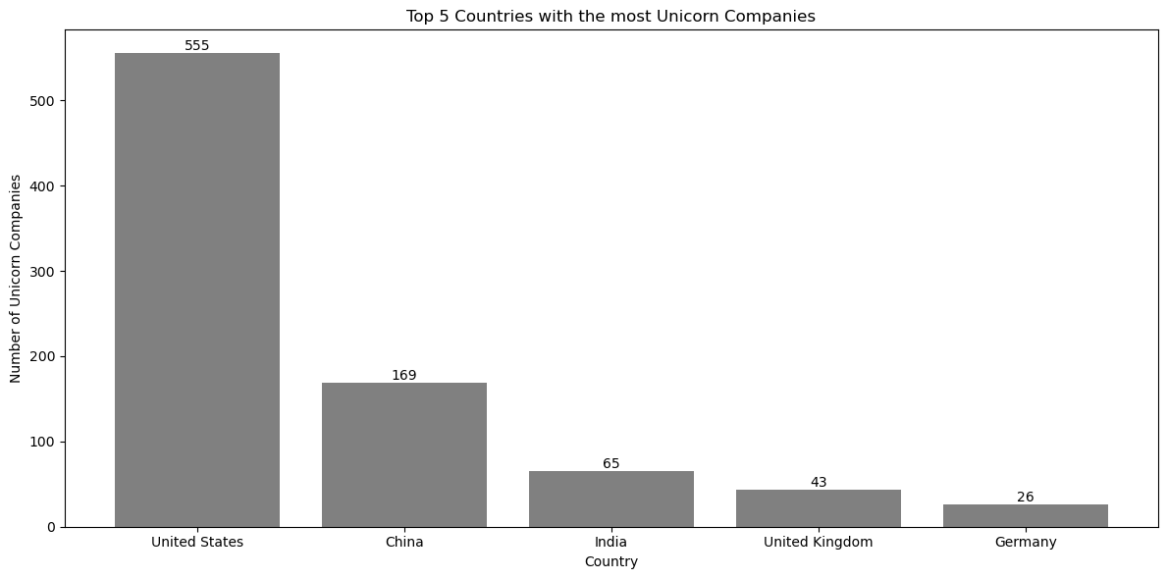
From the data, It can be observed that United States has the highest number of Unicorn Companies
TOP COUNTRIES WITH THE MOST UNICORNS

Slide 4
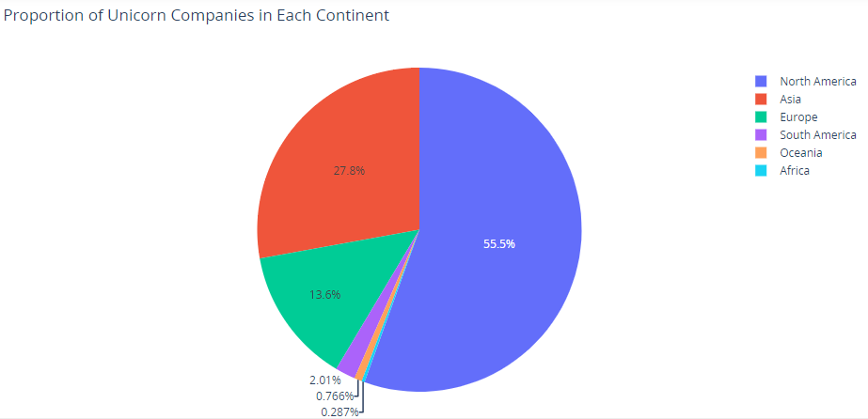
The Continent with the highest number of Unicorn Companies is North America
Percentage of Unicorns Per Continent

Slide 5
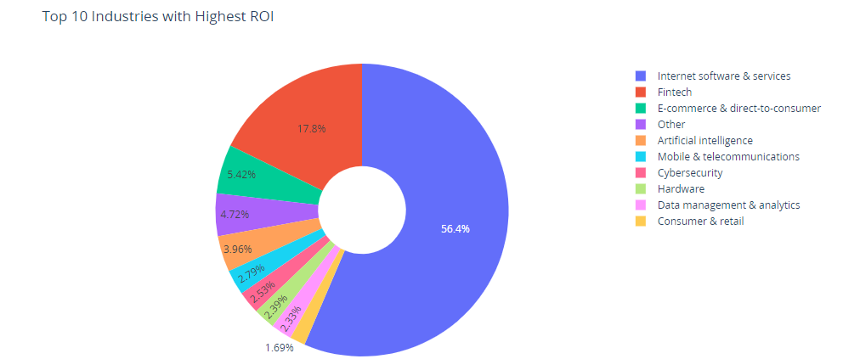
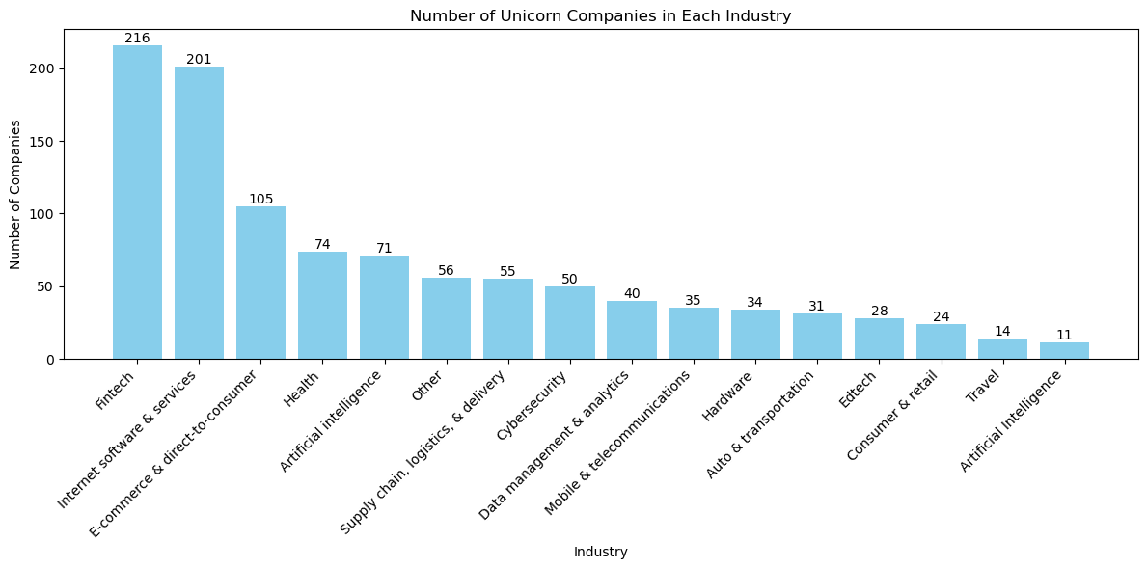
The Fintech and Internet Industry have the highest Unicorns and ROI

Slide 6
RECOMMENDATION
From the analysis, Stakeholders in low valuation industries should Identify industries like Fintech,E-commerce and Internet that have shown consistent high growth in terms of the number of unicorn companies and funding amounts and find means in which they can either create new businesses in those industries or foster collaborations and partnerships with other unicorn companies, industry leaders, and key stakeholders.
The Stakeholders should also keep a close eye on funding trends within specific industries to identify sectors attracting significant investments.
They should evaluate the distribution of unicorn companies across cities and identify cities with high industrial activities and intend to build highly innovative businesses in such cities.
Industries such as Artificial intelligence which have high valuation and low funding might indicate that the company is generating significant profits, allowing it to grow without relying heavily on external capital should be a target for businesses who intend to avoid dependence on external investors

